Slide 1

Environment and Human Population
Dr. Prasenjit Adak

Slide 2
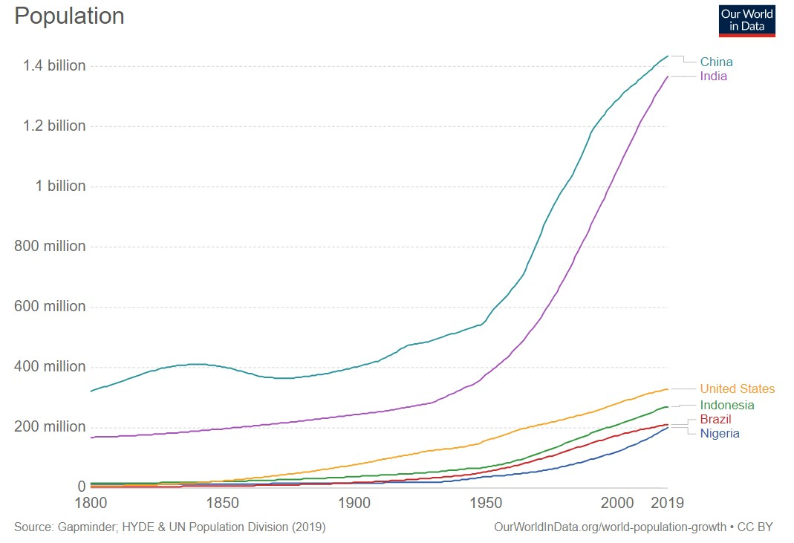
Human Population and Environment
Human population of the world has got doubled during the last 50 years.
The carrying capacity of the planet earth will be greatly stretched and exceeded if the present rate of population growth continues.
This P₁P_{2/}T₀₃s/h₁o₉uld be used as reference only. Reading books (mentioned in syllabus) is mandatory for the preparation of the examinations.

Slide 3
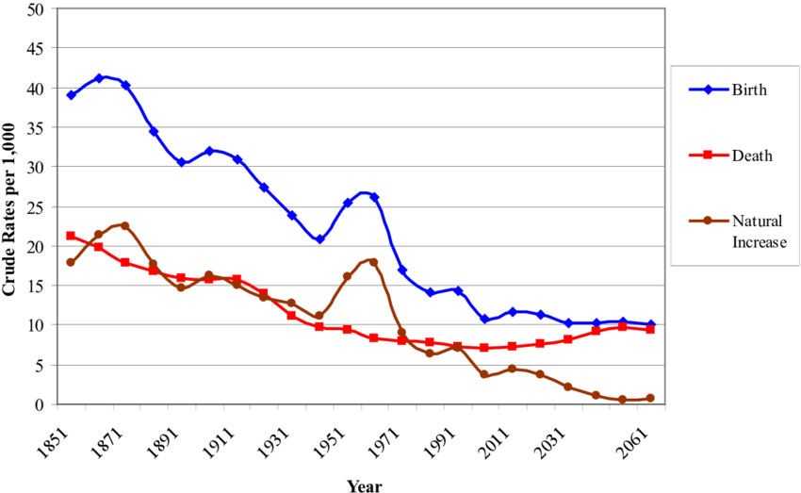
Population Growth
The increase in the number of individuals in a population is known as population growth.
Demography
The study of human population trends is called demography
Factors Deciding the Growth or Decline of
Population
Birth Rate - Number of births per thousand people in a geographical area.
Death rate - Number of deaths per thousand people in a geographical area.
Migration - Rate of change in population for a specific area.
This P₁P_{2/}T₀₃s/h₁o₉uld be used as reference only. Reading books (mentioned in syllabus) is mandatory for the preparation of the examinations.

Slide 4
Population Growth
Causes of Population Growth
Availability of cure for many life-threatening diseases
Preference for sons
Custom of early marriages
Improvement in public health
Illiteracy
Effects of Population Growth
Excessive exploitation of natural resources
Unemployment
Lack of proper health and sanitation facilities
Environmental pollution
This P₁P_{2/}T₀₃s/h₁o₉uld be used as reference only. Reading books (mentioned in syllabus) is mandatory for the preparation of the examinations.

Slide 5
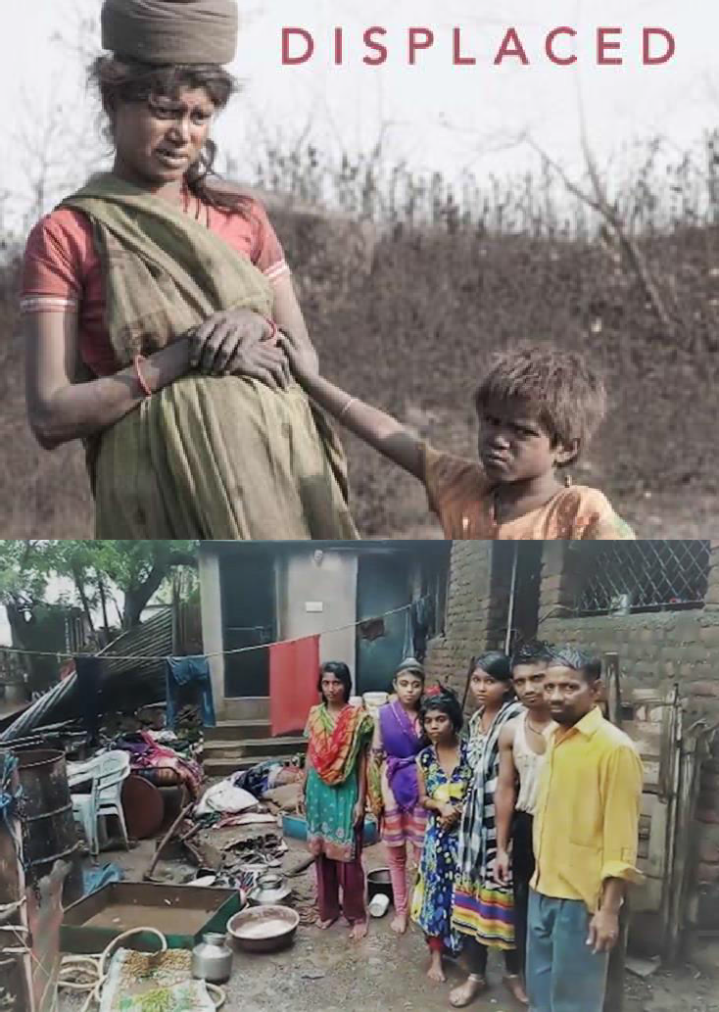
Resettlement and Rehabilitation
Reasons for Displacement of Human
Habitation
Natural hazards – Earthquakes, cyclones, landslides, floods, drought, volcanic eruptions, and epidemic diseases
Anthropogenic factors – Developmental activities such as construction of dams, roads, tunnels, etc., which increase the risks of calamities such as floods and landslides. Other factors include accumulation of wastes and environmental pollution
This P₁P_{2/}T₀₃s/h₁o₉uld be used as reference only. Reading books (mentioned in syllabus) is mandatory for the preparation of the examinations.

Slide 6
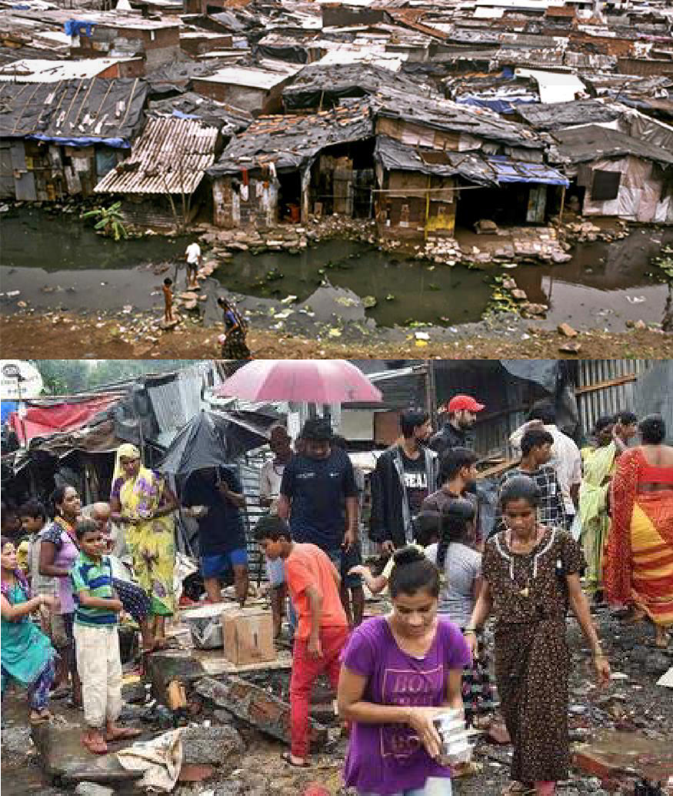
Problems Faced by Displaced People
The compensation for the lost land is often not paid or the payment is delayed.
Basic infrastructure and amenities are not provided in the new area.
Very often, temporary camps become permanent settlements.
Ethnic and caste differences make it difficult for the refugees to live peacefully with the communities already living in the area.
This P₁P_{2/}T₀₃s/h₁o₉uld be used as reference only. Reading books (mentioned in syllabus) is mandatory for the preparation of the examinations.

Slide 7

Environmental Ethics
Creating a moral sense of environmental conservation in each person is called environmental ethics.
The Contrasting Views
of environmental ethics
Utilitarian justification
Ecological
justification
This P₁P_{2/}T₀₃s/h₁o₉uld be used as reference only. Reading books (mentioned in syllabus) is mandatory for the preparation of the examinations.

Slide 8
Environmental Ethics
Environmental Equity and Priority Principle
Always respect all nature especially in cases
where strong human rights are at stake.
Environmental ethics: Possible Solutions.
One should respect the power of environment and apply it for the benefits of humankind.
One should place the highest priority on health, safety, and environmental protection while using environmental products.
One should be sensitive to ethical and social
issues regarding the environment.
This P₁P_{2/}T₀₃s/h₁o₉uld be used as reference only. Reading books (mentioned in syllabus) is mandatory for the preparation of the examinations.

Slide 9
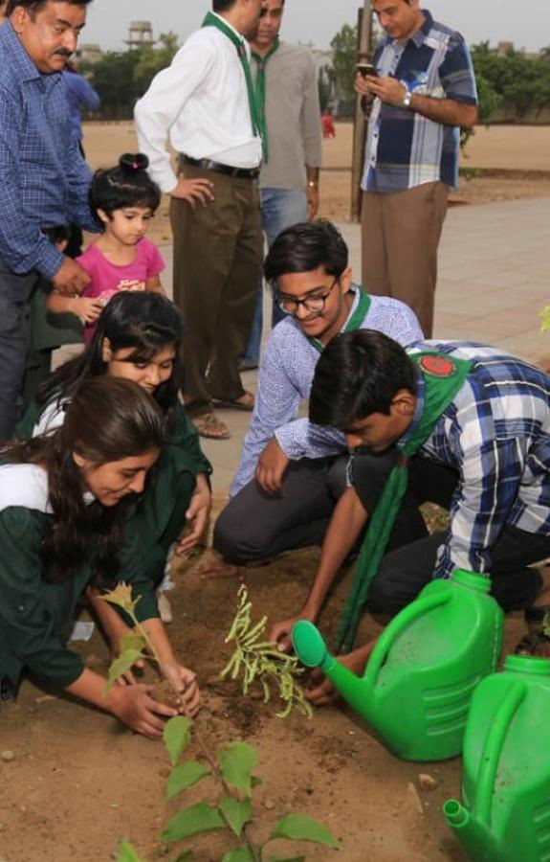
Public Awareness
The methods to generate environmental
awareness generally falls in two categories :
Formal Method
Introduction of Environmental Studies
as a course in schools and colleges.
Non Formal Method
Mass media such as newspapers, magazine, radio, T.V., etc.
Organizing meetings, seminars and
conferences
Organizing various competitions
Through folk songs, street plays, TV
serials, etc.
This P₁P_{2/}T₀₃s/h₁o₉uld be used as reference only. Reading books (mentioned in syllabus) is mandatory for the preparation of the examinations.

Slide 10
Disaster Management
A disaster is defined as a sudden event or calamity that causes large- scale damage and destruction of human life and property.
Types of Disasters
Natural Disasters
• Air-related – Hurricanes, cyclones, storms, etc.
• Water-related – Floods, drought, etc.
Earth-related – Earthquakes, landslides, volcanic eruptions, etc.
Man-made Disasters
• Industrial accidents
• Wars, riots, terrorism, etc.
• Toxic spills
• Transportation accidents
This PPT should be used as reference only. Reading books (mentioned in syllabus) is mandatory for the preparation of the examinations.

Slide 11
Disaster Management
Objectives:
Reduce, or avoid, losses from disasters
Assure assistance to victims
Achieve rapid and effective recovery
Disaster management:
Mitigation: Minimizing the possible effects of a disaster
Preparedness: Planning how to respond to a disaster
Response: Taking immediate measures to save life and property, providing medical relief, etc.
Recovery: Returning the community to normal conditions
This PPT should be used as reference only. Reading books (mentioned in syllabus) is mandatory for the preparation of the examinations.

Slide 12
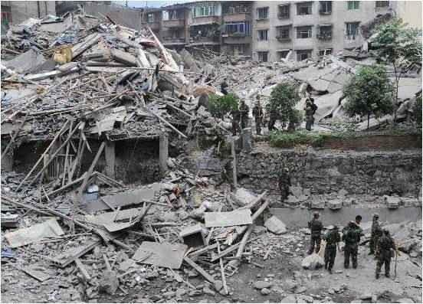
Earthquake
The term earthquake is used to describe any seismic event, caused naturally or as a consequence of human activities, that leads to the generation of devastating seismic waves.
Causes of Earthquake
•Movement of hot gases and magma
•Volcanic activities
•Stress buildup due to water pressure
•Tectonic stress generated by movement of tectonic plates
This PPT should be used as reference only. Reading books (mentioned in syllabus) is mandatory for the preparation of the examinations.

Slide 13
This PPT should be used as reference only. Reading books (mentioned in syllabus) is mandatory for the preparation of the examinations.

Slide 14
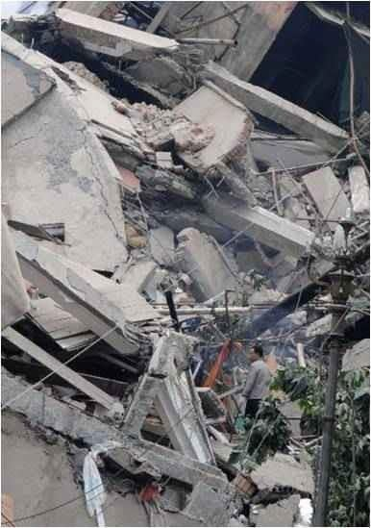
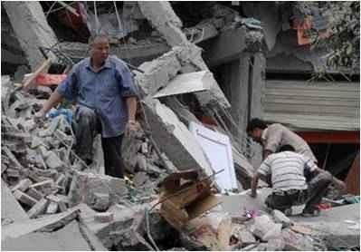
Effects of Earthquake
•Destruction and demolition of buildings, dams, etc. Large-scale damage to life and property
•Increased incidence of fire, landslides, etc.
•Increased incidence of tsunami waves.
This PPT should be used as reference only. Reading books (mentioned in syllabus) is mandatory for the preparation of the examinations.

Slide 15
Management of Earthquakes
•Marking earthquake-sensitive areas
•Construction of houses, factories, dams, bridges, etc., with appropriate design and materials and strategically placed vibration absorbers
•Forecast and early prediction of earthquakes
•Creating public awareness regarding the steps to be taken during
emergencies
•Relief measures through timely support by individuals, government, and non-governmental organizations
This PPT should be used as reference only. Reading books (mentioned in syllabus) is mandatory for the preparation of the examinations.

Slide 16
Landslides
Landslides are natural phenomena during which large amounts of landmass slide downwards from hilly areas, mainly because of gravity, destroying everything lying in the path.
Causes of Landslides
•Earthquakes
•Glaciers and Torrential rain
•Construction of dams, bridges, tunnels, roads, etc
•Use of explosives for breaking rocks during mining
•Deforestation of mountain slopes
This PPT should be used as reference only. Reading books (mentioned in syllabus) is mandatory for the preparation of the examinations.

Slide 17
Effects of Landslides
Rocks, large debris, and sliding landmasses destroy urban and rural habitation
Damage to roads, dams, bridges, etc.
Obstruction of river flow increasing the incidence of flood
Severe damage to crops and agricultural lands
Management of Landslides
Construction activities should be done only after properly evaluating the geological and geographic conditions.
Regulating rate of water flow also helps in controlling landslides.
Agriculture at slopes should be avoided as far as possible.
Relief task through economic help supporting resettlement and rehabilitation of affected people at individual community and organizationallevels should be available
•
•
This PPT should be used as reference only. Reading books (mentioned in syllcabaursr)ieisdmoanudta.tory for the preparation of the examinations.

